Slide 1
Unit -5
Relational–Database Design

Slide 2
Outline of Unit - 5
Pitfalls in Relational-Database designs ,
Concept of normalization
Function Dependencies ,
First Normal Form,
2nd ,
3rd ,
BCNF,

Slide 3
Pitfalls in Relational-Database designs
Relational database design requires that we find a “good”
collection of relation schemas. A bad design may lead to
– Repetition of information
– Inability to represent certain information

Slide 4
Pitfalls in Relational-Database designs
Design Goals:
– Avoid redundant data
– Ensure that relationships among attributes are represented
– Facilitate the checking of updates for violation of database integrity constraints

Slide 5
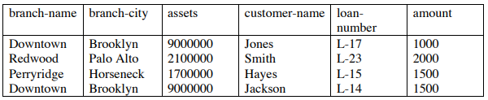
Pitfalls in Relational-Database designs
Example –
Consider the relation schema:
Lending-schema = (branch-name, branch-city, assets,
customer-name, loan-number, amount)

Slide 6
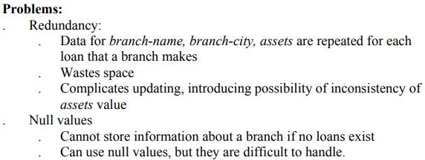
Pitfalls in Relational-Database designs

Slide 7
Pitfalls in Relational-Database designs
Decompose the relation schema Lending-schema into:
Branch-schema = (branch-name, branch-city,assets)
Loan-info-schema = (customer-name, loan-number,
branch-name, amount)
All attributes of an original schema (R) must appear in the decomposition (R₁, R₂):
R = R₁ ∪ R₂
Lossless-join decomposition.
For all possible relations r on schema R
r= ∏_{R1} (r) ∏_{R2} (r)

Slide 8
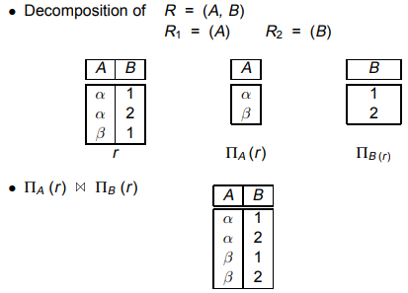
Example of a Non Lossless-Join Decomposition

Slide 9
Goal — Devise a Theory for the Following
Decide whether a particular relation R is in “good” form.
In the case that a relation R is not in “good” form, decompose it into a set of relations {R₁, R₂, ..., R_{n}} such that
  each relation is in good form
  the decomposition is a lossless-join decomposition
Our theory is based on:
  functional dependencies
  multivalued dependencies

Slide 10
Goal — Devise a Theory for the Following
Constraints on the set of legal relations.
Require that the value for a certain set of attributes determines uniquely the value for another set of attributes.
A functional dependency is a generalization of the notion of a key.

Slide 11
Function Dependencies
The functional dependency is a relationship that exists between two attributes. It typically exists between the primary key and non-key attribute within a table.
X → Y
The left side of FD is known as a determinant, the right side of the production is known as a dependent.

Slide 12
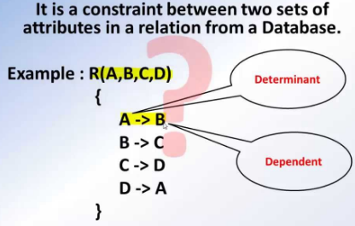
Function Dependencies
For example:

Slide 13
Function Dependencies
For example:
Assume we have an employee table with attributes: Emp_Id, Emp_Name, Emp_Address.
Here Emp_Id attribute can uniquely identify the Emp_Name attribute of employee table because if we know the Emp_Id, we can tell that employee name associated with it.
Functional dependency can be written as:
Emp_Id → Emp_Name
We can say that Emp_Name is functionally dependent on Emp_Id.

Slide 14
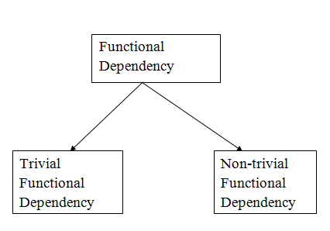
Function Dependencies

Slide 15
Function Dependencies
1. Trivial functional dependency
A → B has trivial functional dependency if B is a subset of A.
The following dependencies are also trivial like: A → A, B → B
Example:
Consider a table with two columns Employee_Id and Employee_Name.
{Employee_id, Employee_Name} → Employee_Id is a trivial functional dependency as
Employee_Id is a subset of {Employee_Id, Employee_Name}.
Also, Employee_Id → Employee_Id and Employee_Name → Employee_Name are trivial dependencies too.

Slide 16
Function Dependencies
1. Trivial functional dependency
The dependency of an attribute on a set of attributes is known as trivial functional dependency if the set of attributes includes that attribute.
Symbolically: A ->B is trivial functional dependency if B is a subset of A.
The following dependencies are also trivial: A->A & B->B
For example: Consider a table with two columns Student_id and Student_Name.
{Student_Id, Student_Name} -> Student_Id is a trivial functional dependency as Student_Id is a subset of {Student_Id, Student_Name}. That makes sense because if we know the values of Student_Id and Student_Name then the value of Student_Id can be uniquely determined.
Also, Student_Id -> Student_Id & Student_Name -> Student_Name are trivial dependencies too.

Slide 17
Function Dependencies
2. Non-trivial functional dependency
A → B has a non-trivial functional dependency if B is not a subset of A.
When A intersection B is NULL, then A → B is called as complete non-trivial.
Example:
ID → Name,
Name → DOB

Slide 18
Function Dependencies
Non trivial functional dependency in DBMS
If a functional dependency X->Y holds true where Y is not a subset of X then this dependency is called non trivial Functional dependency.
For example:
An employee table with three attributes: emp_id, emp_name, emp_address.
The following functional dependencies are non-trivial:
emp_id -> emp_name (emp_name is not a subset of emp_id)
emp_id -> emp_address (emp_address is not a subset of emp_id)

Slide 19
Function Dependencies
Non trivial functional dependency in DBMS
On the other hand, the following dependencies are trivial:
{emp_id, emp_name} -> emp_name [emp_name is a subset of {emp_id, emp_name}]
Refer: trivial functional dependency.
Completely non trivial FD:
If a FD X->Y holds true where X intersection Y is null then this dependency is said to be completely non trivial function dependency.

Slide 20
Function Dependencies
Multivalued dependency in DBMS
Multivalued dependency occurs when there are more than one independent multivalued attributes in a table.
For example: Consider a bike manufacture company, which produces two colors (Black and white) in each model every year.

Slide 21
Function Dependencies
Multivalued dependency in DBMS
Here columns manuf_year and color are independent of each other and dependent on bike_model. In this case these two columns are said to be multivalued dependent on bike_model. These dependencies can be represented like this
bike_model ->> manuf_year
bike_model ->> color
bike_model | manuf_year | color
M1001 | 2007 | Black
M1001 | 2007 | Red
M2012 | 2008 | Black
M2012 | 2008 | Red
M2222 | 2009 | Black
M2222 | 2009 | Red

Slide 22
Function Dependencies
Transitive dependency in DBMS
A functional dependency is said to be transitive if it is indirectly formed by two functional dependencies.
For e.g.
X -> Z is a transitive dependency if the following three functional dependencies hold true:
X->Y
Y does not ->X
Y->Z
Note: A transitive dependency can only occur in a relation of three of more attributes. This dependency helps us normalizing the database in 3NF (3rd Normal Form).

Slide 23
Function Dependencies
Transitive dependency in DBMS
Example: Let’s take an example to understand it better:
{Book} ->{Author} (if we know the book, we knows the author name)
{Author} does not ->{Book}
{Author} -> {Author_age}
Therefore as per the rule of transitive dependency: {Book} -> {Author_age} should hold, that makes sense because if we know the book name we can know the author’s age.
Book | Author | Author_age
Game of Thrones | George R. R. Martin | 66
Harry Potter | J. K. Rowling | 49
Dying of the Light | George R. R. Martin | 66

Slide 24
Concept of Normalization:
Normalization is the process of organizing the data in the database.
Normalization is used to minimize the redundancy from a relation or set of relations. It is also used to eliminate the undesirable characteristics like Insertion, Update and Deletion Anomalies.
Normalization divides the larger table into the smaller table and links them using relationship.
The normal form is used to reduce redundancy from the database table.

Slide 25
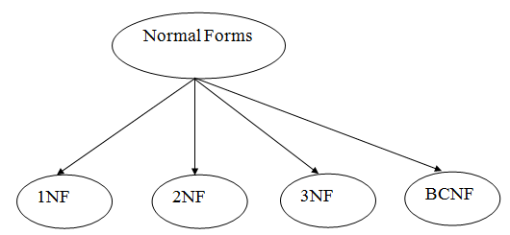
Concept of Normalization:
Types of Normal Forms :

Slide 26
Concept of Normalization:
Types of Normal Forms :
Normal Forms | Description
1NF | A relation is in 1NF if it contains an atomic value.
2NF | A relation will be in 2NF if it is in 1NF and all non-key attributes are fully functional dependent on the primary key.
3NF | A relation will be in 3NF if it is in 2NF and no transition dependency exists.
4NF | A relation will be in 4NF if it is in Boyce Codd normal form and has no multi-valued dependency.
5NF | A relation is in 5NF if it is in 4NF and not contains any join dependency and joining should be lossless.

Slide 27
First Normal Form (1NF) :
A relation will be 1NF if it contains an atomic value.
It states that an attribute of a table cannot hold multiple values. It must hold only single-valued attribute.
First normal form disallows the multi-valued attribute, composite attribute, and their combinations.
Example: Relation EMPLOYEE is not in 1NF because of multi-valued attribute EMP_PHONE.

Slide 28
First Normal Form (1NF) :
S-id | Name | Credits | Dept | Building | Room_no
1 | A | 8 | COMP | B1 | 501
2 | B | 5 | COMP | B1 | 501
3 | C | 6 | IT | B2 | 601
4 | D | 6 | CIVIL | C2 | 301
5 | E | 7 | CIVIL | C2 | 301
6 | F | 9 | COMP | B1 | 501
7 | E | 7 | IT | B2 | 601
8 | G | 5 | IT | B2 | 601

Slide 29
First Normal Form (1NF) :
Example: Relation EMPLOYEE is not in 1NF because of multi-valued attribute EMP_PHONE.
EMPLOYEE table:
EMP_ID | EMP_NAME | EMP_PHONE | EMP_STATE
14 | John | 7272826385, 9064738238 | UP
20 | Harry | 8574783832 | Bihar
12 | Sam | 7390372389, 8589830302 | Punjab

Slide 30
First Normal Form (1NF) :
The decomposition of the EMPLOYEE table into 1NF has been shown below:
EMP_ID | EMP_NAME | EMP_PHONE | EMP_STATE
14 | John | 7272826385 | UP
14 | John | 9064738238 | UP
20 | Harry | 8574783832 | Bihar
12 | Sam | 7390372389 | Punjab
12 | Sam | 8589830302 | Punjab

Slide 31
Second Normal Form (2NF)
In the 2NF, relational must be in 1NF.
In the second normal form, all non-key attributes are fully functional dependent on the primary key
Example: Let's assume, a school can store the data of teachers and the subjects they teach. In a school, a teacher can teach more than one subject.

Slide 32
Second Normal Form (2NF)
ABC D
D is fully FD on ABC
Not on any subset of ABC
AB D
BC D
C D
A D

Slide 33
Second Normal Form (2NF)
An attribute is fully functional dependent on another attribute, if it is Functionally Dependent on that attribute and not on any of its proper subset. For example, an attribute Q is fully functional dependent on another attribute P, if it is Functionally Dependent on P and not on any of the proper subset of P.

Slide 34
Second Normal Form (2NF)
In the 2NF, relational must be in 1NF.
In the second normal form, all non-key attributes are fully functional dependent on the primary key
Example: Let's assume, a school can store the data of teachers and the subjects they teach. In a school, a teacher can teach more than one subject.

Slide 35
Second Normal Form (2NF)
TEACHER table
In the given table, non-prime attribute TEACHER_AGE is dependent on TEACHER_ID which is a proper subset of a candidate key. That's why it violates the rule for 2NF
TEACHER_ID | SUBJECT | TEACHER_AGE
25 | Chemistry | 30
25 | Biology | 30
47 | English | 35
83 | Math | 38
83 | Computer | 38

Slide 36
Second Normal Form (2NF)
To convert the given table into 2NF, we decompose it into two tables:
TEACHER_DETAIL Table: TEACHER_SUBJECT table:
TEACHER_ID | TEACHER_AGE
25 | 30
47 | 35
83 | 38
TEACHER_ID | SUBJECT
25 | Chemistry
25 | Biology
47 | English
83 | Math
83 | Computer

Slide 37
Third Normal Form (3NF)
A relation will be in 3NF if it is in 2NF and not contain any transitive partial dependency.
3NF is used to reduce the data duplication. It is also used to achieve the data integrity.
If there is no transitive dependency for non-prime attributes, then the relation must be in third normal form.

Slide 38
Third Normal Form (3NF)
What is Transitive Dependency
When an indirect relationship causes functional dependency it is called Transitive Dependency.
If P -> Q and Q -> R is true, then P-> R is a transitive dependency.
To achieve 3NF, eliminate the Transitive Dependency.

Slide 39
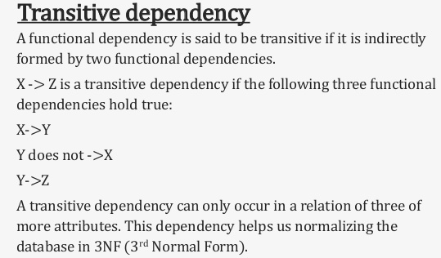
Third Normal Form (3NF)

Slide 40
Third Normal Form (3NF)
A relation is in third normal form if it holds atleast one of the following conditions for every non-trivial function dependency X → Y.
X is a super key.
Y is a prime attribute, i.e., each element of Y is part of some candidate key.

Slide 41
Third Normal Form (3NF)
Example
<MovieListing>
Movie_ID | Listing_ID | Listing_Type | DVD_Price ($)
M08 | L09 | Crime | 180
M03 | L05 | Drama | 250
M05 | L09 | Crime | 180

Slide 42
Third Normal Form (3NF)
Example
<MovieListing>
The above table is not in 3NF because it has a transitive functional dependency −
Movie_ID -> Listing_ID
Listing_ID -> Listing_Type
Therefore, the following has transitive functional dependency.
Movie_ID -> Listing_Type
The above states the relation <MovieListing> violates the 3rd Normal Form (3NF).

Slide 43
Third Normal Form (3NF)
To remove the violation, you need to split the tables and remove the transitive functional dependency.
<Movie> <Listing>
Now the above relation is in Third Normal Form (3NF) of Normalization.
Movie_ID | Listing_ID | DVD_Price ($)
M08 | L09 | 180
M03 | L05 | 250
M05 | L09 | 180
<Listing> | Listing_Type
L09 | Crime
L05 | Drama
L09 | Crime

Slide 44
Third Normal Form (3NF)
Example:
EMPLOYEE_DETAIL table:
EMP_ID | EMP_NAME | EMP_ZIP | EMP_STATE | EMP_CITY
222 | Harry | 201010 | UP | Noida
333 | Stephan | 02228 | US | Boston
444 | Lan | 60007 | US | Chicago
555 | Katharine | 06389 | UK | Norwich
666 | John | 462007 | MP | Bhopal

Slide 45
Third Normal Form (3NF)
Super key in the table above:
{EMP_ID}, {EMP_ID, EMP_NAME}, {EMP_ID, EMP_NAME, EMP_ZIP}....so on
Candidate key: {EMP_ID}
Non-prime attributes: In the given table, all attributes except EMP_ID are non-prime.
Here, EMP_STATE & EMP_CITY dependent on EMP_ZIP and EMP_ZIP dependent on EMP_ID. The non-prime attributes (EMP_STATE, EMP_CITY) transitively dependent on super key(EMP_ID). It violates the rule of third normal form.

Slide 46
Third Normal Form (3NF)
That's why we need to move the EMP_CITY and EMP_STATE to the new <EMPLOYEE_ZIP> table, with EMP_ZIP as a Primary key.
EMPLOYEE table: EMPLOYEE_ZIP table:
EMP_ID | EMP_NAME | EMP_ZIP
222 | Harry | 201010
333 | Stephan | 02228
444 | Lan | 60007
555 | Katharine | 06389
666 | John | 462007
EMP_ZIP | EMP_STATE | EMP_CITY
201010 | UP | Noida
02228 | US | Boston
60007 | US | Chicago
06389 | UK | Norwich
462007 | MP | Bhopal

Slide 47
Boyce Codd normal form (BCNF)
BCNF is the advance version of 3NF. It is stricter than 3NF.
A table is in BCNF if every functional dependency X → Y, X is the super key of the table.
For BCNF, the table should be in 3NF, and for every FD, LHS is super key.

Slide 48
Boyce Codd normal form (BCNF)
Example: Let's assume there is a company where employees work in more than one department.
EMPLOYEE table:
EMP_ID | EMP_COUNTRY | EMP_DEPT | DEPT_TYPE | EMP_DEPT_NO
264 | India | Designing | D394 | 283
264 | India | Testing | D394 | 300
364 | UK | Stores | D283 | 232
364 | UK | Developing | D283 | 549

Slide 49
Boyce Codd normal form (BCNF)
EMP_ID → EMP_COUNTRY
EMP_DEPT → {DEPT_TYPE, EMP_DEPT_NO}
Candidate key: {EMP-ID, EMP-DEPT}
The table is not in BCNF because neither EMP_DEPT nor EMP_ID alone are keys.
To convert the given table into BCNF, we decompose it into three tables:

Slide 50
Boyce Codd normal form (BCNF)
EMP_COUNTRY table: EMP_DEPT table:
EMP_DEPT_MAPPING table:
EMP_ID | EMP_COUNTRY
264 | India
264 | India
EMP_DEPT | DEPT_TYPE | EMP_DEPT_NO
Designing | D394 | 283
Testing | D394 | 300
Stores | D283 | 232
Developing | D283 | 549
EMP_ID | EMP_DEPT
D394 | 283
D394 | 300
D283 | 232
D283 | 549

Slide 51
Boyce Codd normal form (BCNF)
Functional dependencies:
EMP_ID → EMP_COUNTRY
EMP_DEPT → {DEPT_TYPE, EMP_DEPT_NO}
Candidate keys:
For the first table: EMP_ID
For the second table: EMP_DEPT
For the third table: {EMP_ID, EMP_DEPT}
Now, this is in BCNF because left side part of both the functional dependencies is a key.

Slide 52
Fourth normal form (4NF)
A relation will be in 4NF if it is in Boyce Codd normal form and has no multi-valued dependency.
For a dependency A → B, if for a single value of A, multiple values of B exists, then the relation will be a multi-valued dependency.
Example : STUDENT
STU_ID | COURSE | HOBBY
21 | Computer | Dancing
21 | Math | Singing
34 | Chemistry | Dancing
74 | Biology | Cricket
59 | Physics | Hockey

Slide 53
Fourth normal form (4NF)
The given STUDENT table is in 3NF, but the COURSE and HOBBY are two independent entity. Hence, there is no relationship between COURSE and HOBBY.
In the STUDENT relation, a student with STU_ID, 21 contains two courses, Computer and Math and two hobbies, Dancing and Singing. So there is a Multi-valued dependency on STU_ID, which leads to unnecessary repetition of data.

Slide 54
Fourth normal form (4NF)
So to make the above table into 4NF, we can decompose it into two tables:.
STUDENT_COURSE STUDENT_HOBBY
STU_ID | COURSE
21 | Computer
21 | Math
34 | Chemistry
74 | Biology
59 | Physics
STU_ID | HOBBY
21 | Dancing
21 | Singing
34 | Dancing
74 | Cricket
59 | Hockey

